Slide 1
Parameters set for the call committee by OPS
Keep same number of people on call and use the extra manpower to decrease backlog.
Provide coverage for CH Saturdays
Provide MR coverage starting at 8 am
Provide clear contact person for techs.
Cover DCR office STATs until 8PM, Mon-Thurs and until 5 PM Friday and Saturday. No DCR STATs on Sunday.
Work within limits of Qgenda and already published call schedule.
Notes:
Questions:

Slide 2
PHX call repurposed: Weeknight
PHX
CCH CT
PM reader
CT1
CT2
PM reader
*DCR office STAT CR/US/CT 5-7p are the responsibility of both CT1 and CT2.
*CT1 will be contact person for DCR office STAT CR/US/CT 5-7p (occasionally 8p)
*CT1 will read office cross sectional cases during the day.

Slide 3
PHX call repurposed: Weekend
CCH1
CCH2
PHX
MR call
CCH1
CCH2
CCH3
CCH4/MR call
*CCH3 position is a routine cross sectional reader (CT +/- MR).
*CCH2 is also responsible for DCR office STAT CR/US/CT 8a-5p (sat only)

Slide 4
Job definitions
Rotation | Call Duties
Weeknight CT1 (10a-7p) DCR office CT/MRI + CCH CT 10-7 + office stats til 8p | CCH CT (ER and IP) 5-7p DCR office STAT CR/US/CT 5-7p *Mon to Thurs may have office stats until 8p
Weeknight CT2 (10a-7p) CCH CT weeknight call | CCH CT (ER and IP) 5-7p
Weeknight PM reader (10a-7p) | CCH CR/US (ER and IP) 5-7p, CCH MRI STAT/ASAP 5-7p
CCH OR studies | Goes to CCH 3 person Friday and Saturday, Office helper Sun-Thurs
Weekend CCH1 (10a-7p) | CCH CT (ER and IP) 10a-5p CCH CT/CR/US (ER and IP) 5p-7p
Weekend CCH2 (8a-5p) | CCH CT/CR/US (ER and IP) 8-10a CCH CR/US (ER and IP) 10a-5p DCR STAT CR/US/CT 8a-5p (SAT only)
Weekend CCH3 (10a-7p) | Routine CT +/- MR 10a-5p CCH CT/CR/US (ER and IP) 5p-7p
Weekend CCH4 (8a-5p) Routine CT and all MRI | CCH CT/CR/US (ER and IP) 8-10a MR STAT/ASAP + routine MR/CT 10a-5p
IR call | IR + Fluoro + STAT CTA + equivalent of ½ day of diagnostic imaging

Slide 5
Explanation for the next two slides
The following two slides for weekend call contain the same information, presented two different ways.
- The first layout is the way it will look in Qgenda i.e. one job per
row, rads will be swapped. The swaps are color coded.
- The second layout is how it will look in your calendar i.e one rad
per row, jobs are already swapped.
Note: We have included the initials of the rads who will be on call the Weekend of 4/10 for reference.

Slide 6
Non-holiday Weekend 1 swapping CCH1 and 3 rads on sat and CCH1 and 2 rads on Sun
 | Friday | Saturday | Sunday
CCH1 (CT ER/IP) 10a-7p | Routine sched 10a-5p CCH CT ER/IP 5-7p | CCH CT (ER/IP) 10a-5p* CCH CT/CR/US (ER/IP) 5-7p | CCH CT (ER/IP) 10a-5p* CCH CT/CR/US (ER/IP) 5p-7p
CCH2(CR/US) 8a-5p | Routine sched 8a-5p | CCH CT/CR/US (ER/IP) 8-10a CCH CR/US (ER/IP) 10a-5p DCR STAT CR/US/CT 8a-5p (maybe @ CH or remote) | CCH CT/CR/US (ER/IP) 8-10a* CCH CR/US (ER/IP)10a-5p
CCH3 (Routine CT) 10a-7p | Routine sched10a-5p* CCH CT ER/IP 5-7p | Routine CT +/- MR 10a-5p* CCH CT/CR/US (ER/IP) 5-7p | Routine CT +/- MR 10a-5p CCH CT/CR/US (ER/IP) 5-7p
CCH4 (Routine CT and all MRI) 8a-5 | Routine sched 10a-5p CCH CR/US 5-7p MR STAT/ASAP 5-7p | CCH CT/CR/US (ER/IP) 8-10a MR STAT/ASAP + routine MR/CT 10a-5p | CCH CT/CR/US (ER/IP) 8-10a MR STAT/ASAP + routine MR/CT 10a-5p

Slide 7
Non-holiday Weekend 2 example
 | Friday | Sat | Sun
LP | CT1 CT ER/IP 5-7 (10-7) | CCH3 Routine CT/MR 10-5 CCH CR/US/CT 5-7p (10-7) | CCH2 CCH CT/CR/US (ER/IP) 8-10a CCH CR/US 10-5 (8-5)
MP | Routine schedule (8-5:30) | CCH2 CCH CT/CR/US (ER/IP) 8-10a CCH CR/US 10-5 DCR STAT CR/US/CT 8-5 (8-5) | CCH1 CT (ER/IP) 10-7 CCH CR/US/CT (ER/IP) 5-7p (10-7)
BJ | CT2 CT ER/IP 5-7 (10-7) | CCH1 CT ER/IP 10-7 CCH CR/US/CT (ER/IP) 5-7p (10-7) | CCH3 Routine CT/MR 10-5 CCH CR/US/CT (ER/IP) 5-7p (10-7)
RS | PM reader MR 5-7 CR/US 5-7 (10-7) | CCH4 CCH CR/US/CT (ER/IP) 8-10a MR/CT 10-5 (8-5) | CCH4 CCH CR/US/CT (ER/IP) 8-10a MR/CT 10-5 (8-5)

Slide 8
Details: Shared lists
It is important for equitability and for patient care that we keep filters open. This is especially critical during the 8-10a and 5-7p periods.
For reason of clarity for the techs, certain responsibilities may be assigned to one person but it is understood that the lists are shared.
See next slide for how to set Thinair filters.
Sort Thinair by TATE.

Slide 9
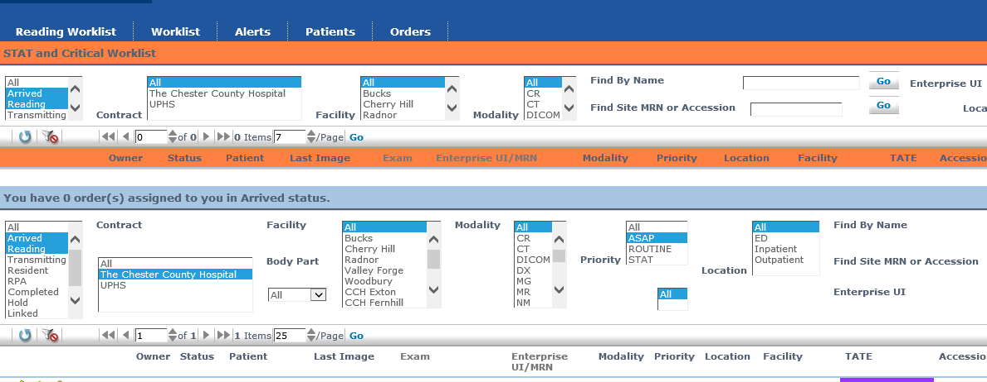

Slide 10
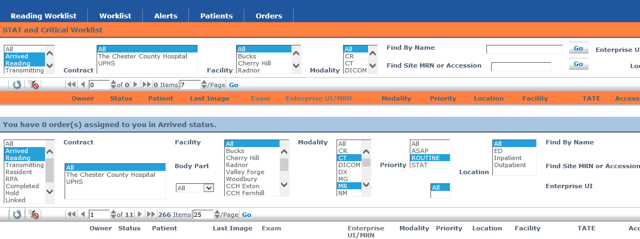


Slide 11
Details: weeknights
CT1 and CT2 share a list.
CT1 is the primary contact person for offices. Note that Mon-Thur offices may have occasional stats 7-8p.
CT1 will read office cross sectional cases during the day (10a-5p).
Pm reader may get calls for cases after 7p e.g. rapid stroke, cord compression.

Slide 12
Details: CCH3
Routine CT/MR person (CCH3) should :
-Focus on older cases and read in chronological order. Purple
first then red etc.
-Avoid skipping cases unless they fall outside general radiology
practice (e.g. Lung cancer screening). Do not skip routine studies like
oncology follow-up, lung nodule f/up or spine CT which are within
every radiologist's competency regardless of sub specialization.
- OPS has set the RVU range for CCH3 between 33-44/day to match the
daily workload of other weekend call workers. Given the range of
RVU values for exams a rough estimate is 25-33 CTs/day or 17-23
MRs/day.

Slide 13
IR call responsibilities
Chester County Hospital urgent and emergent afterhours IR cases and consults
STAT Pediatric UGIs for rule out malrotation
STAT CTA head and neck without perfusion
STAT CTA lower extremity runoffs
½ day equivalent of diagnostic imaging routine work on weekend call if allowable

